Slide 1



STAFF-FLOW
AN AI-POWERED EMPLOYEE SHIFT & WORKLOAD MANAGER
Streamlining Workforce Management for Small & Medium Businesses
Date: March 19, 2025
Prepared By: Fiza Amjad, Shahmir Ahmed, Abdullah Azher Chaudhary
Presented to: Dr. Khalidoon Rashid

Slide 2


PROBLEM STATEMENT
Have you ever been stuck juggling last-minute shift changes, scrambling to track employee hours, or drowning in scheduling chaos—wondering if there’s a better way?
Inefficient manual scheduling
Employees lack transparency
Managers waste hours planning shifts
Tracking work hours and overtime
What if there was a smarter, simpler way to manage all this?

Slide 3

SOLUTION: STAFF-FLOW
An AI-powered workforce management platform for small and medium-sized businesses.
Automates shift scheduling, boosts employee coordination, and streamlines payroll tracking.

Slide 4

ACCEPTANCE CRITERIA
AI scheduling reduces manual effort with accurate suggestions.
Managers get a real-time, intuitive dashboard.
Employees access schedules, request changes, and receive notifications seamlessly.
Payroll tracks hours and overtime reliably.
Pilot testing confirms usability and satisfaction.

Slide 5


TOOL USED : JIRA , CONFLUENCE & FIGMA
Using Jira with 6 sprints; currently in Sprint-02.
Agile with Scrum: Weekly iterations, user feedback-driven
Confluence to create meeting notes and Retrospective Reports.
Figma for Wireframes and UI/UX
Feature: These are the main and core qualities of the project
Epics: Which are smaller chunks of feature
User Stories: Are smaller than epics and Specific user needs
Tasks: Actionable steps under User Stories

Slide 6

ROLES AND SKILLS
Fiza - Scrum Master
Abdullah - Developer Team
Shahmir - Product Owner
Shahmir Ahmed (2022-CS-215) - Product Owner & Testing Expert Guides the vision, prioritizes features.
Fiza Amjad (2022-CS-172) - UI/UX Designer, Documentation Lead & and drives AI functionality.
Abdullah Azher Chaudhry (2022-CS-204) - Full-Stack Developer (Development Team) Builds the backbone of StaffFlow with end-to-end technical expertise.

Slide 7

HOW WE USE JIRA & CONFLUENCE?
Scrum Master: Designed initial features and epics, linked them in Jira.
Product Owner: Added features to the backlog in Jira for prioritization.
Dev Team: Reviewed feasibility of features and epics.
Scrum Master: Created user stories in Jira, tied them to epics after team review.
Team: Assigned tasks in Jira based on finalized user stories.
Retrospective: Generated reports in Confluence to evaluate progress and improvements.
Note: Everything is maintained on Jira and Confluence

Slide 8
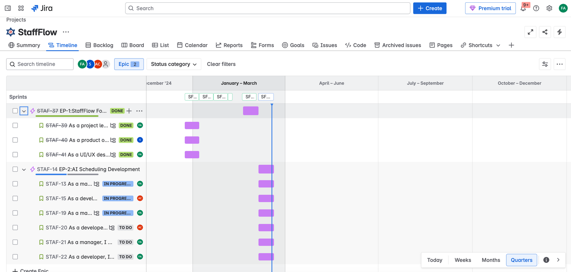
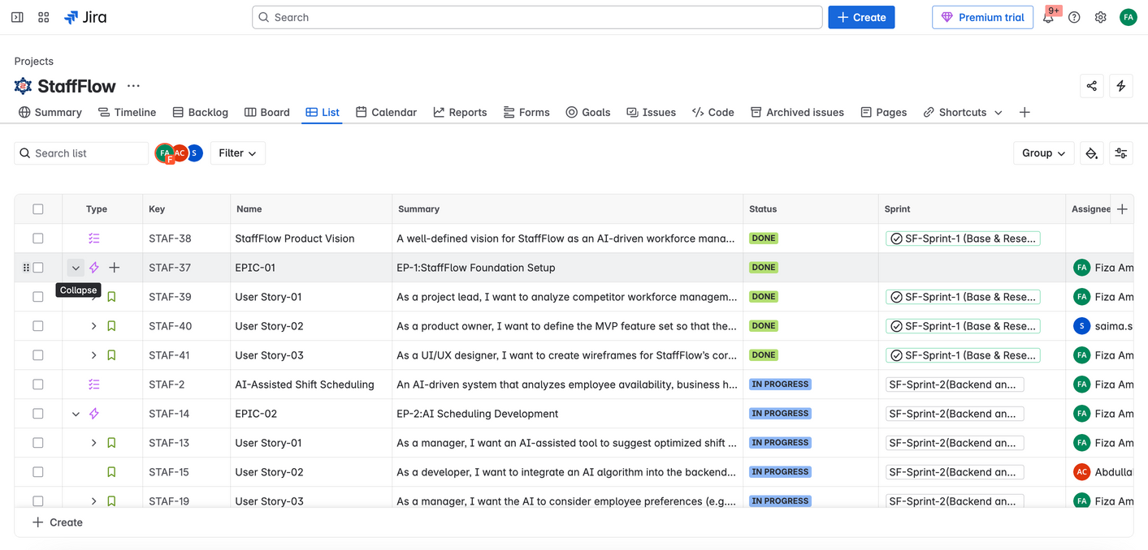
SNAPSHOTS OF JIRA AND CONFLUENCE
Note: Everything is maintained on Jira and Confluence

Slide 9
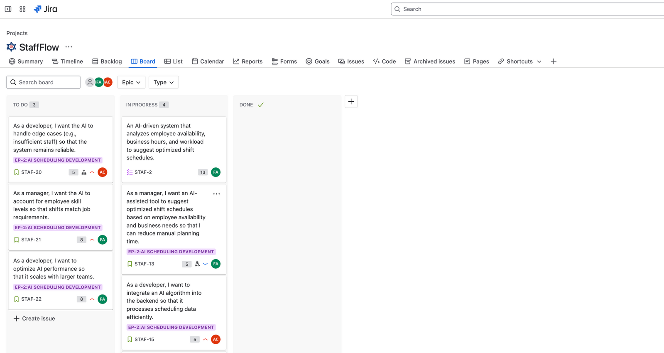
SNAPSHOTS OF JIRA AND CONFLUENCE
Note: Everything is maintained on Jira and Confluence

Slide 10
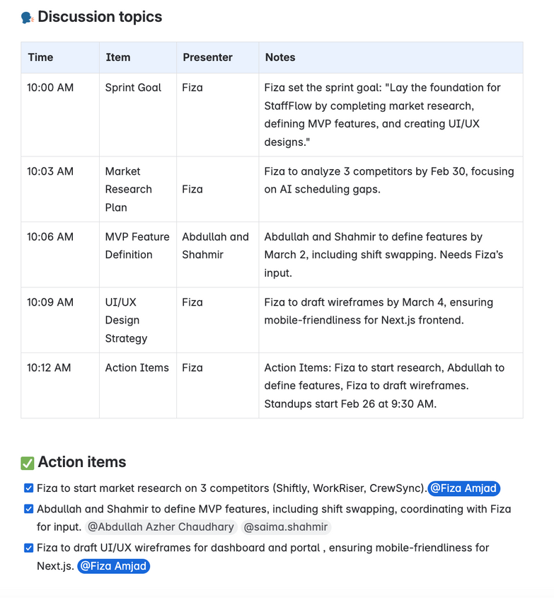
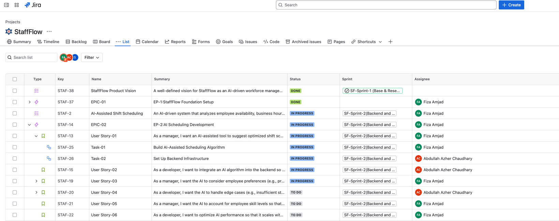
SNAPSHOTS OF JIRA AND CONFLUENCE
Note: Everything is maintained on Jira and Confluence

Slide 11
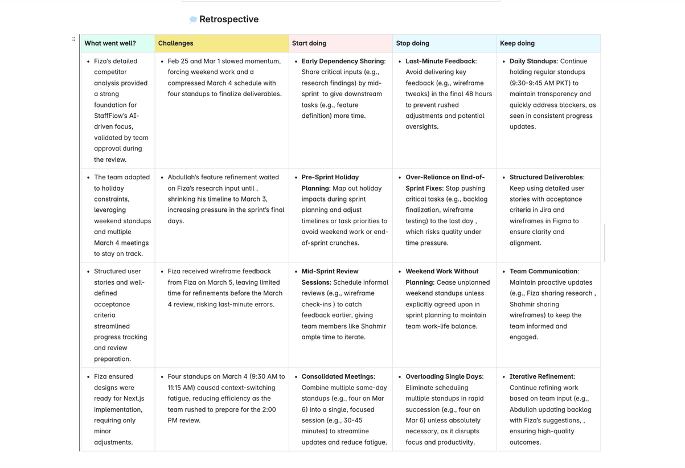
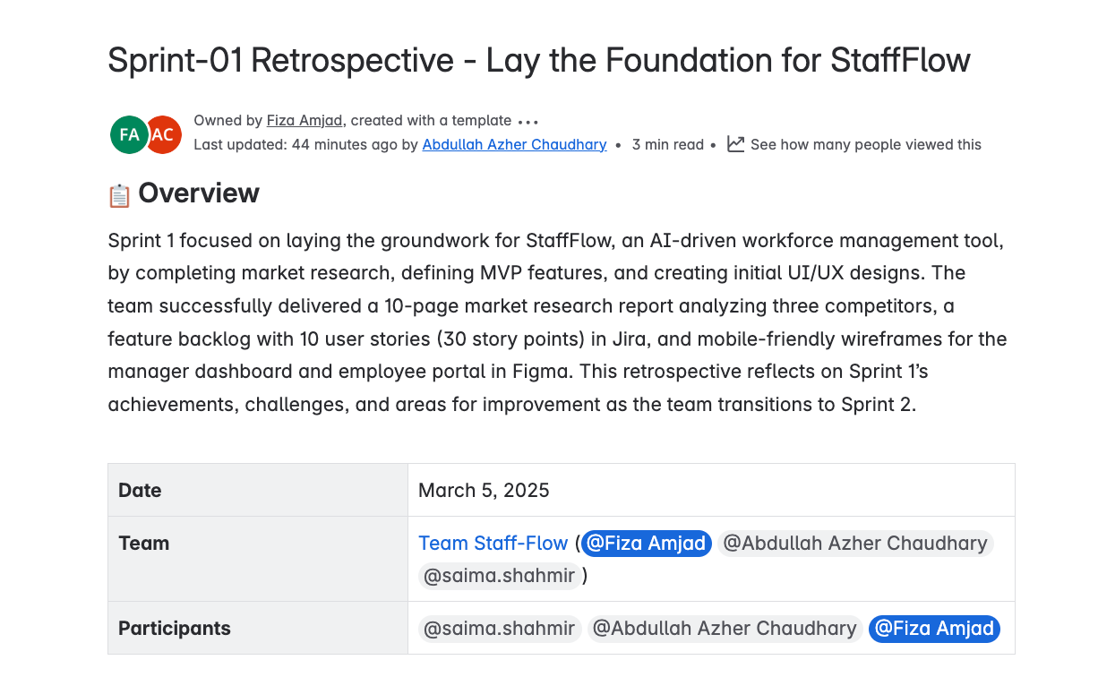
SNAPSHOTS OF JIRA AND CONFLUENCE
Note: Everything is maintained on Jira and Confluence

Slide 12
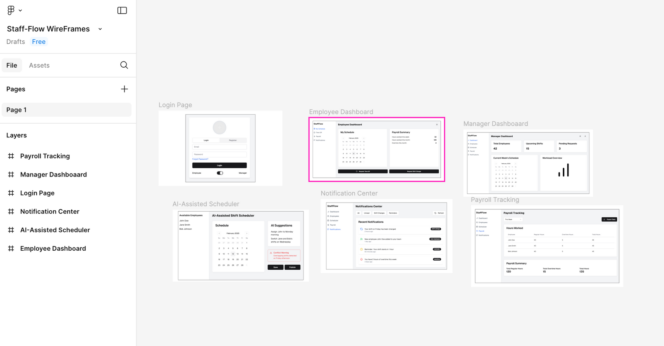
SNAPSHOT OF FIGMA WIREFRAMES
Note: Everything is maintained on Jira and Confluence

Slide 13

With Jira and Confluence, we manage StaffFlow’s journey from vision to victory, sprint by sprint.
THANKYOU
Note: Everything is maintained on Jira and Confluence

